Slide 1
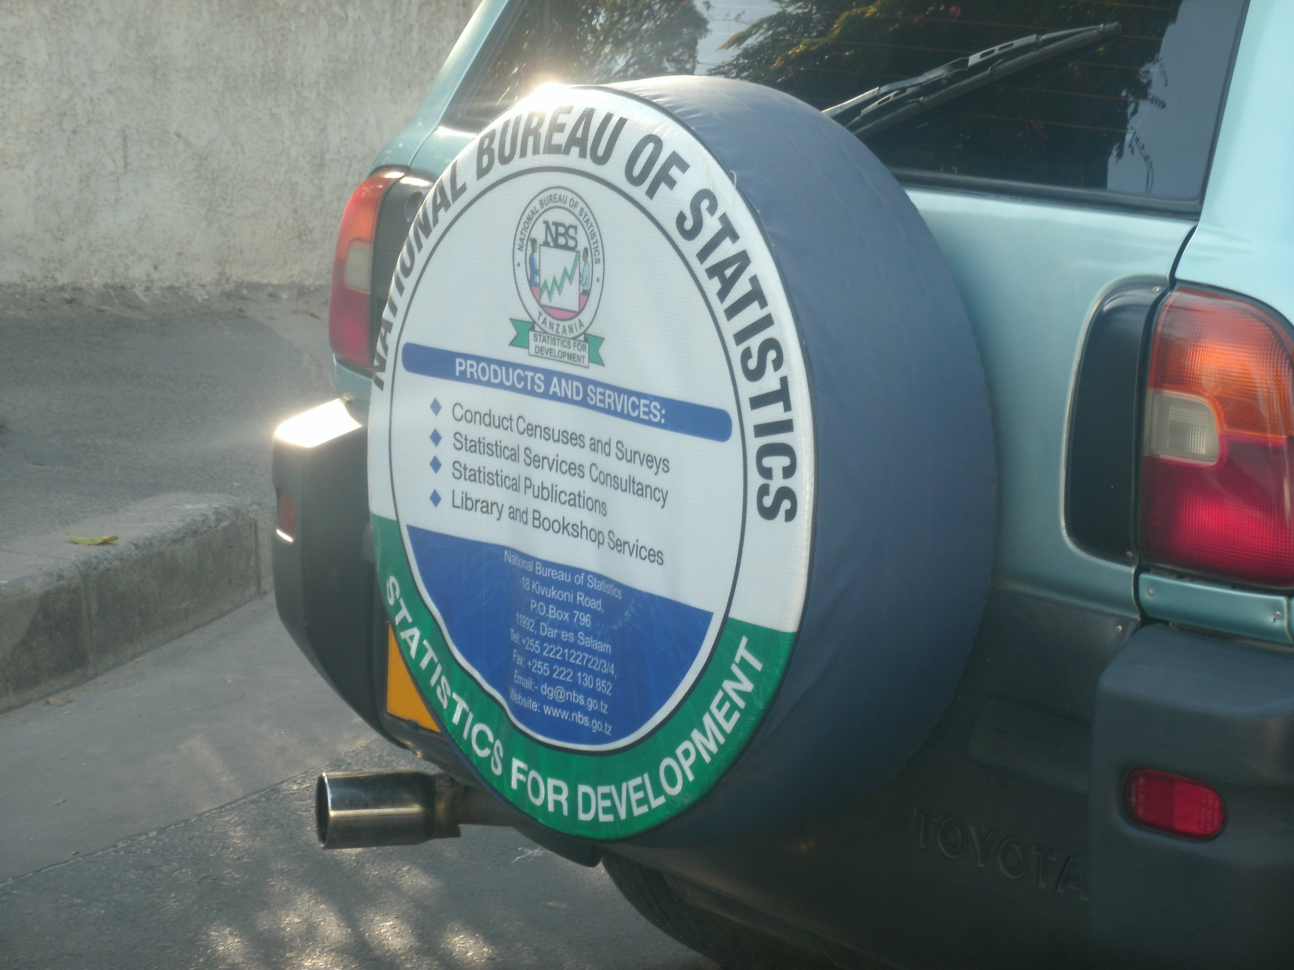
Dar cars
Data collected on trip for the
PAMCA conference, October 2015
Paul Kaefer,
Visiting Statistician

Slide 2
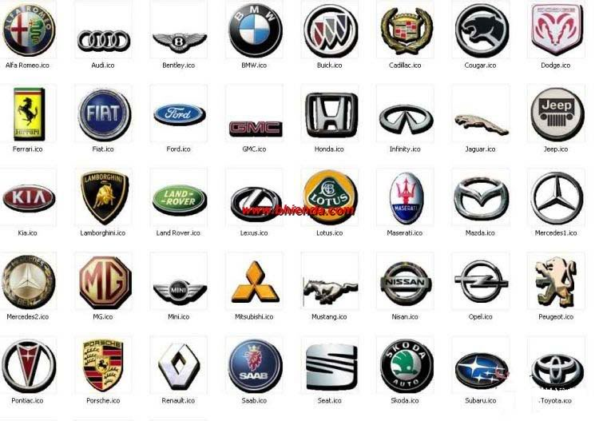
What’s my research question?
Mercy asks, “What are the two most common cars in Dar es Salaam?”

Slide 3
How do I answer?
By collecting ample data, of course.
Hypothesis: definitely something Toyota

Slide 4
How many is ample?
The World Almanac 2015 says Tanzania has 1.8 motor vehicles per 1,000 pop (U.S. has 798)
Wolfram|Alpha says 2.7 million people in Dar es Salaam and 3 in metro area
If 50 million people in TZ, then 50,000 * 1.8 = 90,000 cars
If cars evenly dispersed, there are 5,400 in Dar
I suspect most cars are in Dar. Let’s say 70,000.
Notes:
70,000: better to aim high (7/9 cars are in Dar)

Slide 5
Sample size?
Survey guidelines at https://www.surveymonkey.com/mp/sample-size/
Suggest that for 95% confidence for a population of 100,000, a good sample size is 383
I surveyed 356 cars
Notes:
Calculator at http://www.surveysystem.com/sscalc.htm
Suggests that 95% confidence, for 70,000 pop size, need 266 for CI of 6; 8445 for CI of 1
So I can estimate a proportion, ±6%?

Slide 6
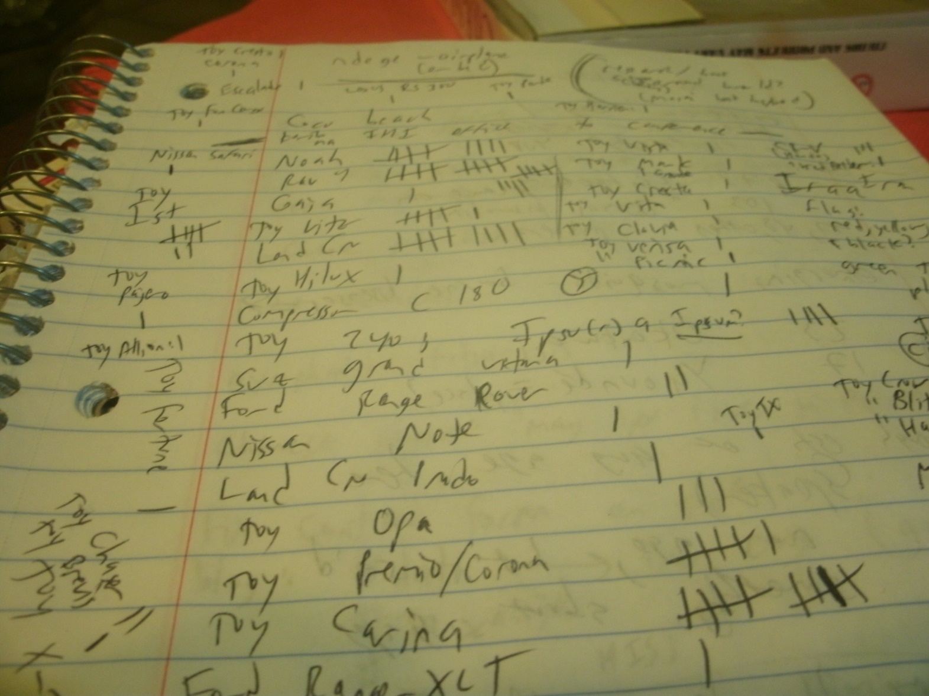
Methodology
Notes:
I tallied as many as I could see whizzing by, as I looked out the window of our moving car.

Slide 7
Short answer
Toyota RAV4 (14.6%)
Toyota ist (8.4%)
Toyota Noah (7.3%)

Slide 10
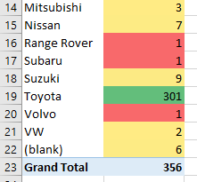
Data analysis: PivotTable
How many cars by make (brand)?

Slide 11
Note logarithmic axis, since so many Toyotas!

Slide 12
Discussion
Mercy said Passo and Vitz
She’s been to more parts of Dar than I have
Vitz was 6th place in my study
Passo was tied for 11th place
Nico agreed with my results
Bajaji na piki piki: nyingi sana

Slide 13
Problems
Skewed/biased results
Limited mostly to rush hour
Limited mostly to “posh” areas and downtown
I may have double-counted some (I tried not to)

Slide 14
Suggestions for future work
Select “watching points” randomly
Watch the same place for maybe an hour?
Count bajaji/piki piki brands?
Record:
MAKE – MODEL – TIME/DATE – LICENSE PLATE
(recording license plate eliminates duplicates)
Ask the department of transportation/motor vehicles for their statistics

Slide 15
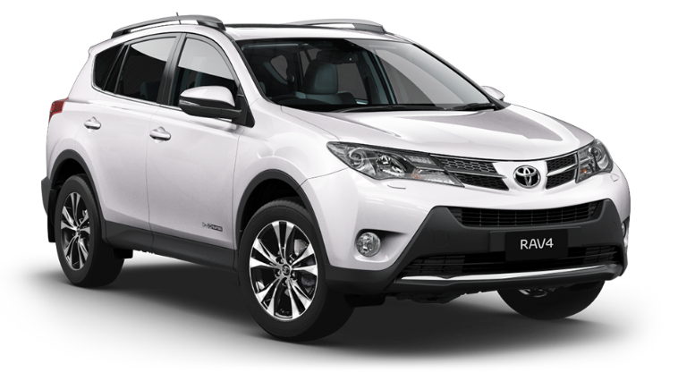
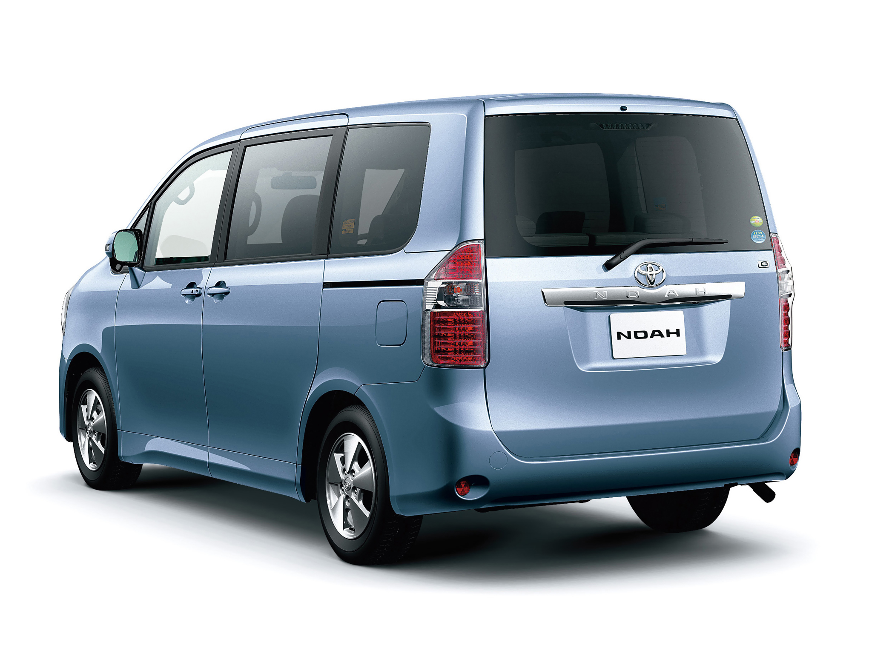
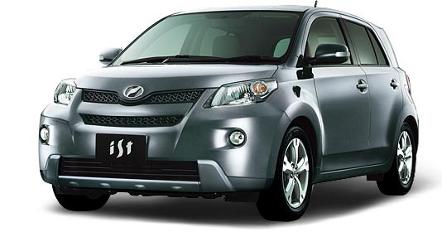
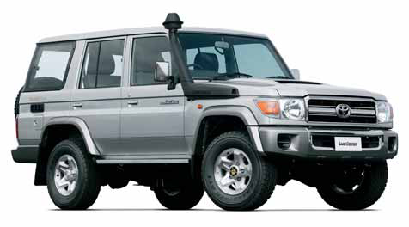
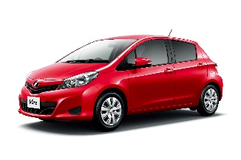
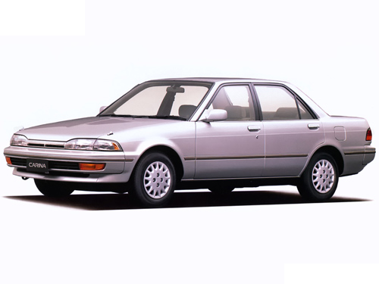
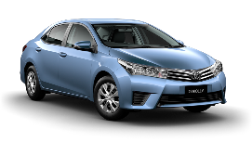
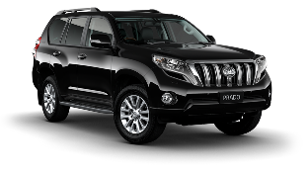
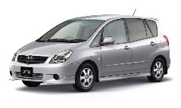
How can we visualize the data?
What about a car graph instead of a bar graph
ist: 8.4%
RAV4: 14.6%
Noah: 7.3%
Carina: 3.9%
Land Cruiser: 5%
Vitz: 3.6%
Corolla, Prado, Spacio: 3%

Slide 16









How can we visualize the data?
…or a graphic with bigger logos for companies that have more cars
84.6%
2.5%
2%
1%
2%
0.6%
0.8%
0.8%
0.6%

Slide 17

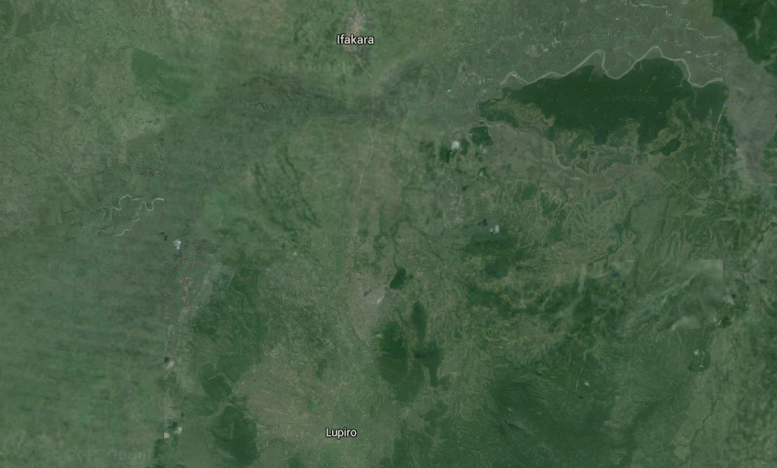










Visualize mosquitoes like this?
DISCLAIMER: this example is fictional
Ifakara
Culex
Anopheles Gambiae
Anopheles Funestus
Anopheles Arabiensis
Lupiro

Slide 18
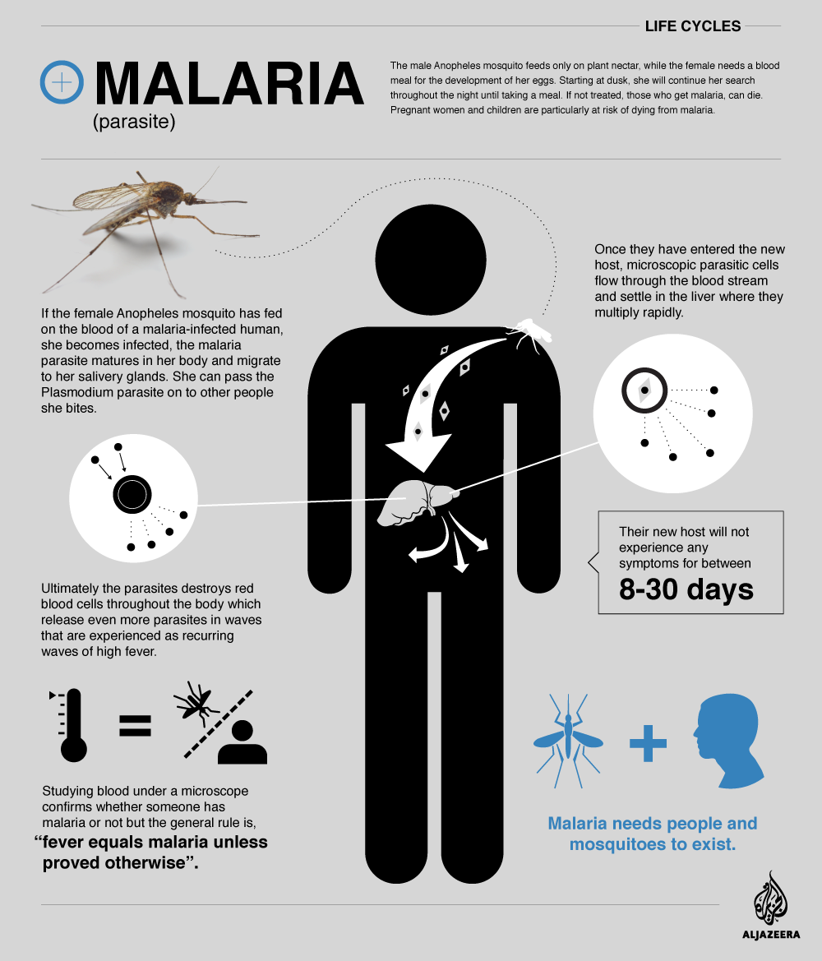
Another example (Al Jazeera)

Slide 19

How can I apply this to my work?
Use PivotTables to see different “slices” of data
Think about different “pictures” of data
Google Image search “Infographics”

Slide 20

Why did I present this?
Example for how you can structure a study
Shows how I think about experiments
It’s silly/fun

